Slide 1
Composite Beam Bending
ASEN 2001 Lab 3 Fall 2018

Slide 2

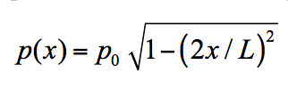
Lab 3 – Wing design and test
aerodynamic loading
=36”
Plan view:
Cross section:
width
Balsa wood
Foam

Slide 3
To do list – Nov 12th
Composite beam (rectangular plan form) will be provided
Work on designing the wing plan form width function w(x)
w = 4”
width

Slide 4
Designing the wing plan form
width
Identify distributed loading:
Per unit area:
Per unit length:
First assume constant w: Used only to compute load per unit length , set

Slide 5
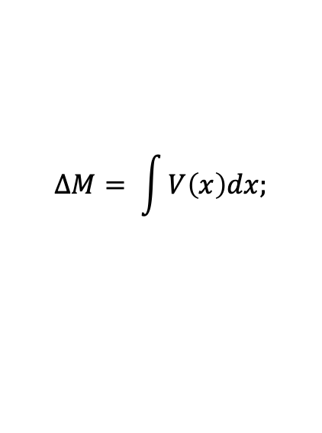
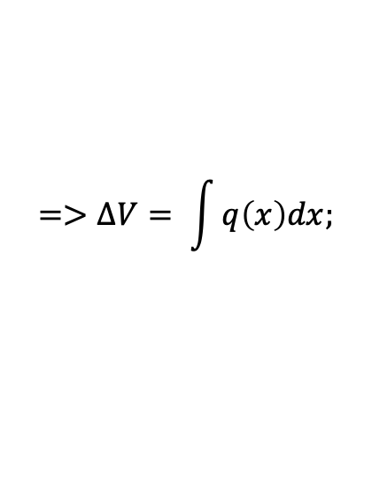
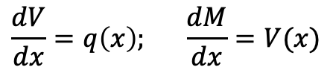
Designing the wing plan form
Shear and moment:
Remarks:
Shear and moment are functions of which is unknown.
First compute support reactions at each end, then use the fact that derivative of shear force is the external distributed load and that derivative of bending moment is the shear force
Make sure that your integration is consistent with the values at the end points. x = - L/2 to 0 and 0 to L/2. Remember x = 0 is defined at the center of the wing!
MATLAB’s symbolic tool is useful for this purpose to solve integrals for and x symbolically
$$\frac{dV}{dx}=q\left(x\right); \frac{dM}{dx}=V(x)$$
$$=>∆V= \int{q\left(x\right)dx;}$$
$$∆M= \int{V\left(x\right)dx;}$$

Slide 6
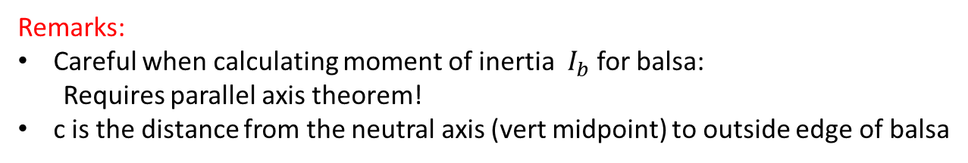
Recall – First identify beam strength
Bending failure:
moment diagram
flexture formula
Test data
Flexure formula:
balsa
foam
Remarks:
Careful when calculating moment of inertia $I_{b}$ for balsa:
Requires parallel axis theorem!
c is the distance from the neutral axis (vert midpoint) to outside edge of balsa

Slide 7
Recall – First identify beam strength
Shear failure:
shear diagram
shear formula
Test data
Shear formula:
foam
Remarks:
Notice shear failure is dependent on dimensions of the foam

Slide 8


Designing the wing plan form
width
Determine optimized w(x) over wing length such that:
$$σ_{fail} determined from testdata.xls$$
$$τ_{fail} determined from testdata.xls$$
Remarks:
At we set , i.e., the optimal width at is . This allows solving for
from as is the only unknown at when moment is maximum.
We compute w(x) at discrete values using obtained above and the
design conditions for shear and moment.
Overlay two plots of w(x) and design a single w(x) function that maximizes width where needed to design around BOTH shear and moment failures along the length of the wing.

